Slide 1

Code Refactoring and Bug Fixing

Slide 2
About me :
Myself Lekhan, working as an Assistant Engineer in TCS
Completed my graduation as a Mechanical Engineer in 2021 from National Institute of technology, Warangal
Data Science was my field of interest from the beginning, working on this since 2 years.
The way Data science uses the combination of Machine Learning with Statistics and Calculus is fascinating
The advancement in the field Machine Learning like GPT’s and LLM’s caught my interest.
I want to build my career in this field and contribute to the fullest

Slide 3
1. Scenario
A team of enthusiastic data scientists embarked on a mission to develop a Note Taking Application using Python, Flask, and HTML. However, their lack of experience in backend development has led to challenges in making the application fully functional. Recognizing your proficiency in backend development, you have been tasked with fixing the broken code and ensuring the application works seamlessly.
2. Objective
Refactor the existing codebase and ensure the proper functioning of the Note Taking Application. Document all identified bugs during the debugging process.

Slide 4
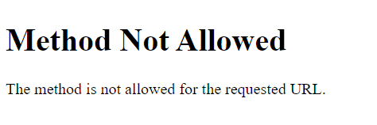
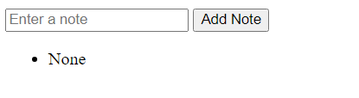
Bug-1 :
The given source file was run on a virtual environment the and the image beside shows us the initial error message when the website is deployed on a local server.
This bug has occurred since the
code file has the request type as
‘POST’ and the html template has
no request type was mentioned, so
by default the request is considered
as ‘get’ type.
To resolved this bug we add the request type ‘get’ in code file.

Slide 5
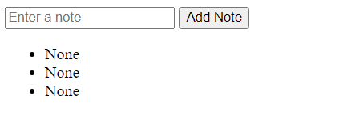


Bug-2 :
After the bug-1 is removed the resulting website is shown beside.
Even we are able to give the notes as input but notes entered as None.
To resolve this bug we need to change the syntax of the route method to ‘request.form.get()’ since the request is of ‘post’ type.
After the change of the syntax the code is able to take the notes as input and output the each note below.

Slide 6
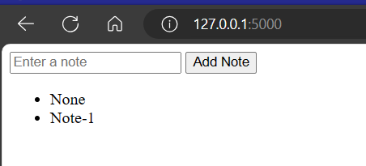
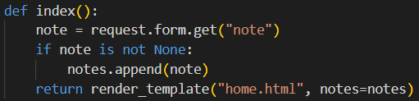
Bug-3 :
After the bug-1 is removed the resulting website is shown beside.
The website is able to display all which are given as input but first note is taken as ‘None’ as shown beside.
Since the html page has no parameter to sent back.
To resolve this issue we can add an ‘if’ condition to filter the notes list as shown beside.

Slide 7
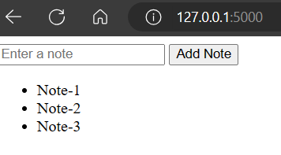
3. Conclusion
Total of three bugs were discovered form the given code and the bugs were resolved.
The snapshot of the website after the bug fixing is shown below.

Slide 8

THANK YOU

